Slide 1
Implementation of Mobile (Pulsed-Laser) Fiber-Optic Sensors for High-Res Lunar Seismicity and Sub-Surface Resource Detection
Distributed Acoustic Sensing (DAS) for Lunar Habitat General Safety & Lunar Resource Mining – a multi-purpose utility
Proposal & Concept Design: Michael Ricciardi marz62@yahoo.com

Slide 2
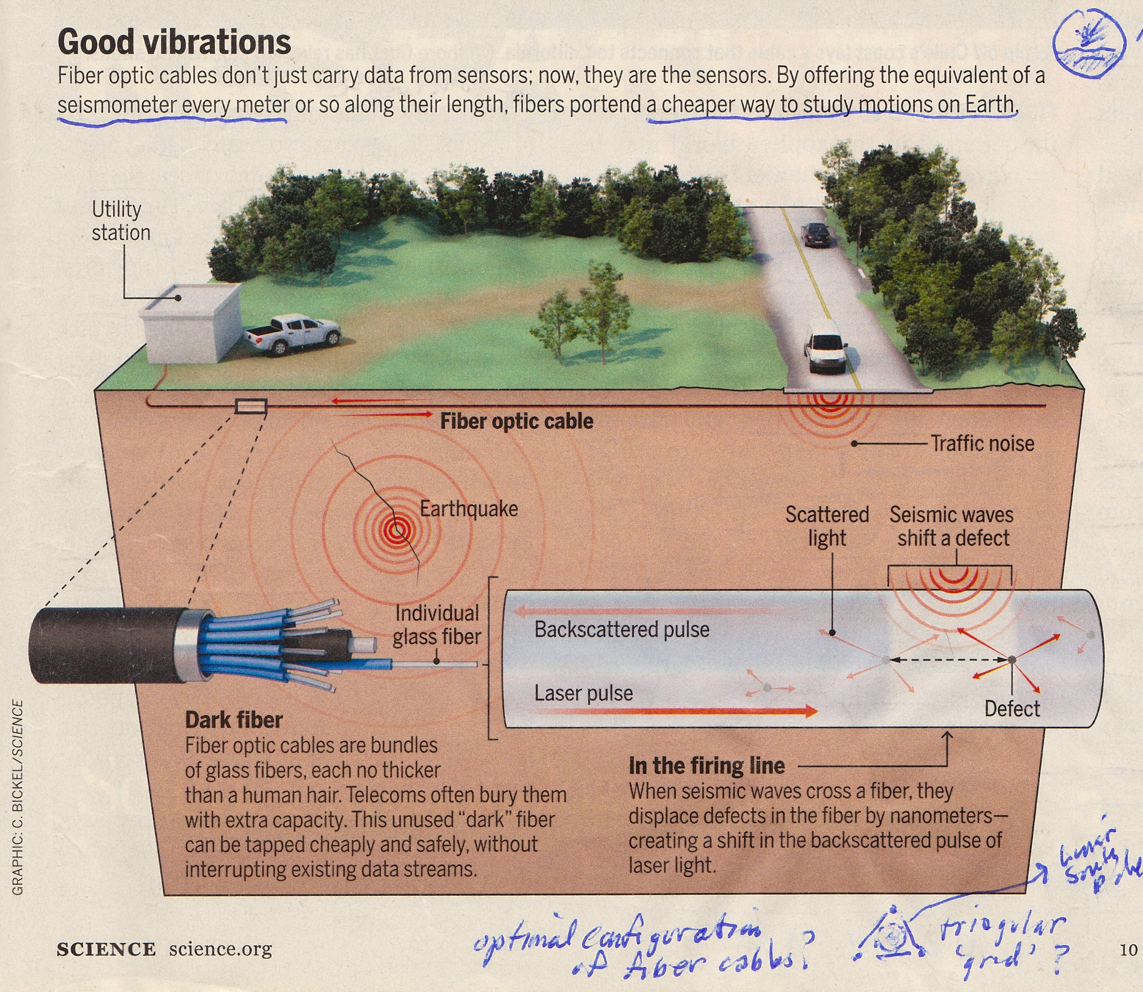
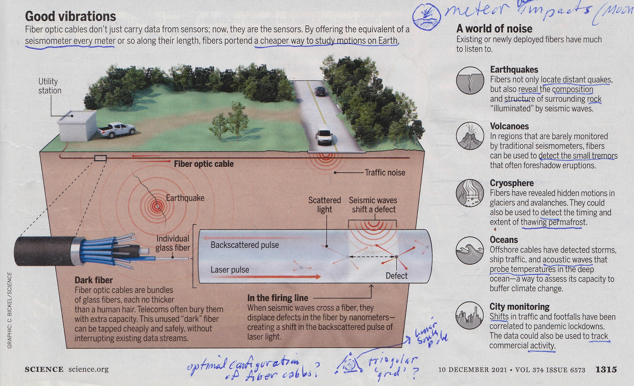
Implementations/Applications of a Pulsed-Laser Fiber-Optic Cable “Interrogator” (source: Science – 10 Dec, 2021, pg. 1315)

Slide 3
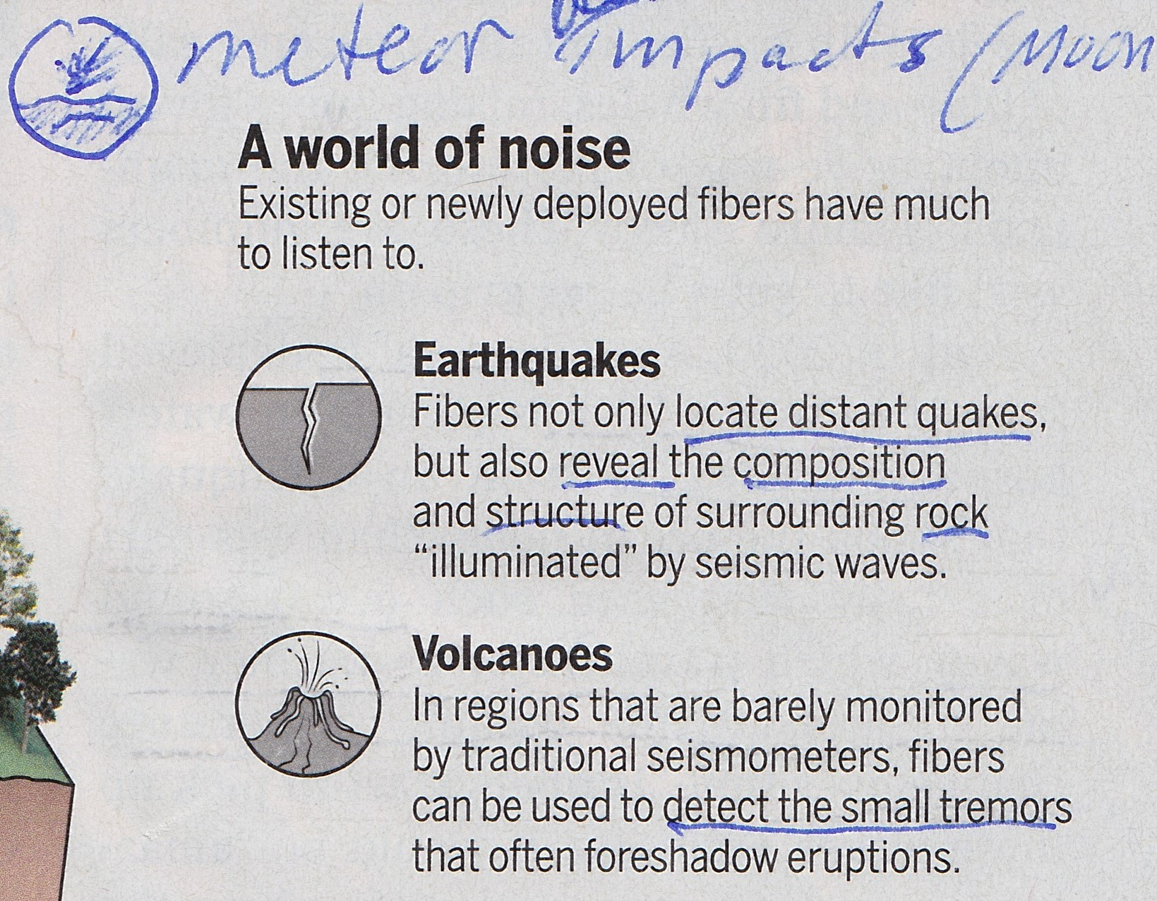
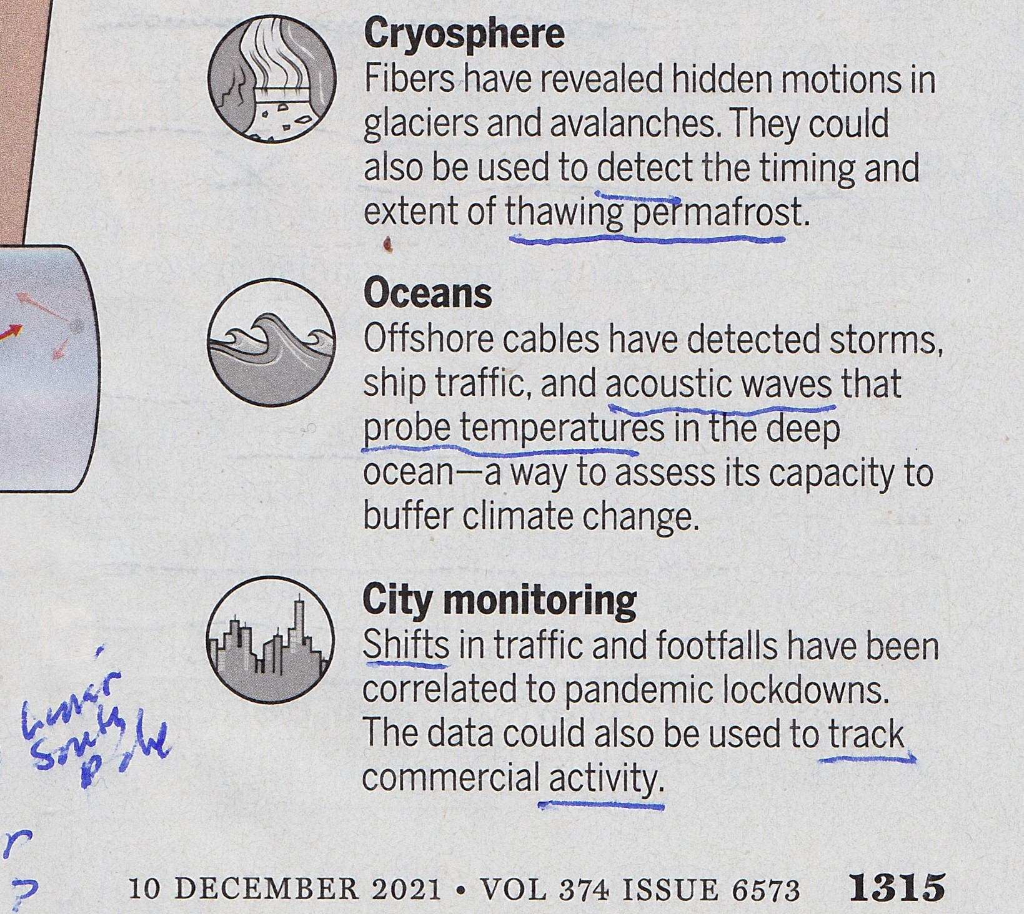
BENEFITS:
Thousands of sensors (equivalent) per single cable
Multi-purpose usage
High-resolution temporal/spatial data
Low cost & efficient (time, maintenance)
Enable/facilitate (future) quantum-classical communication capacity
FO Cables may be manufactured in situ (using silica from lunar regolith)

Slide 4
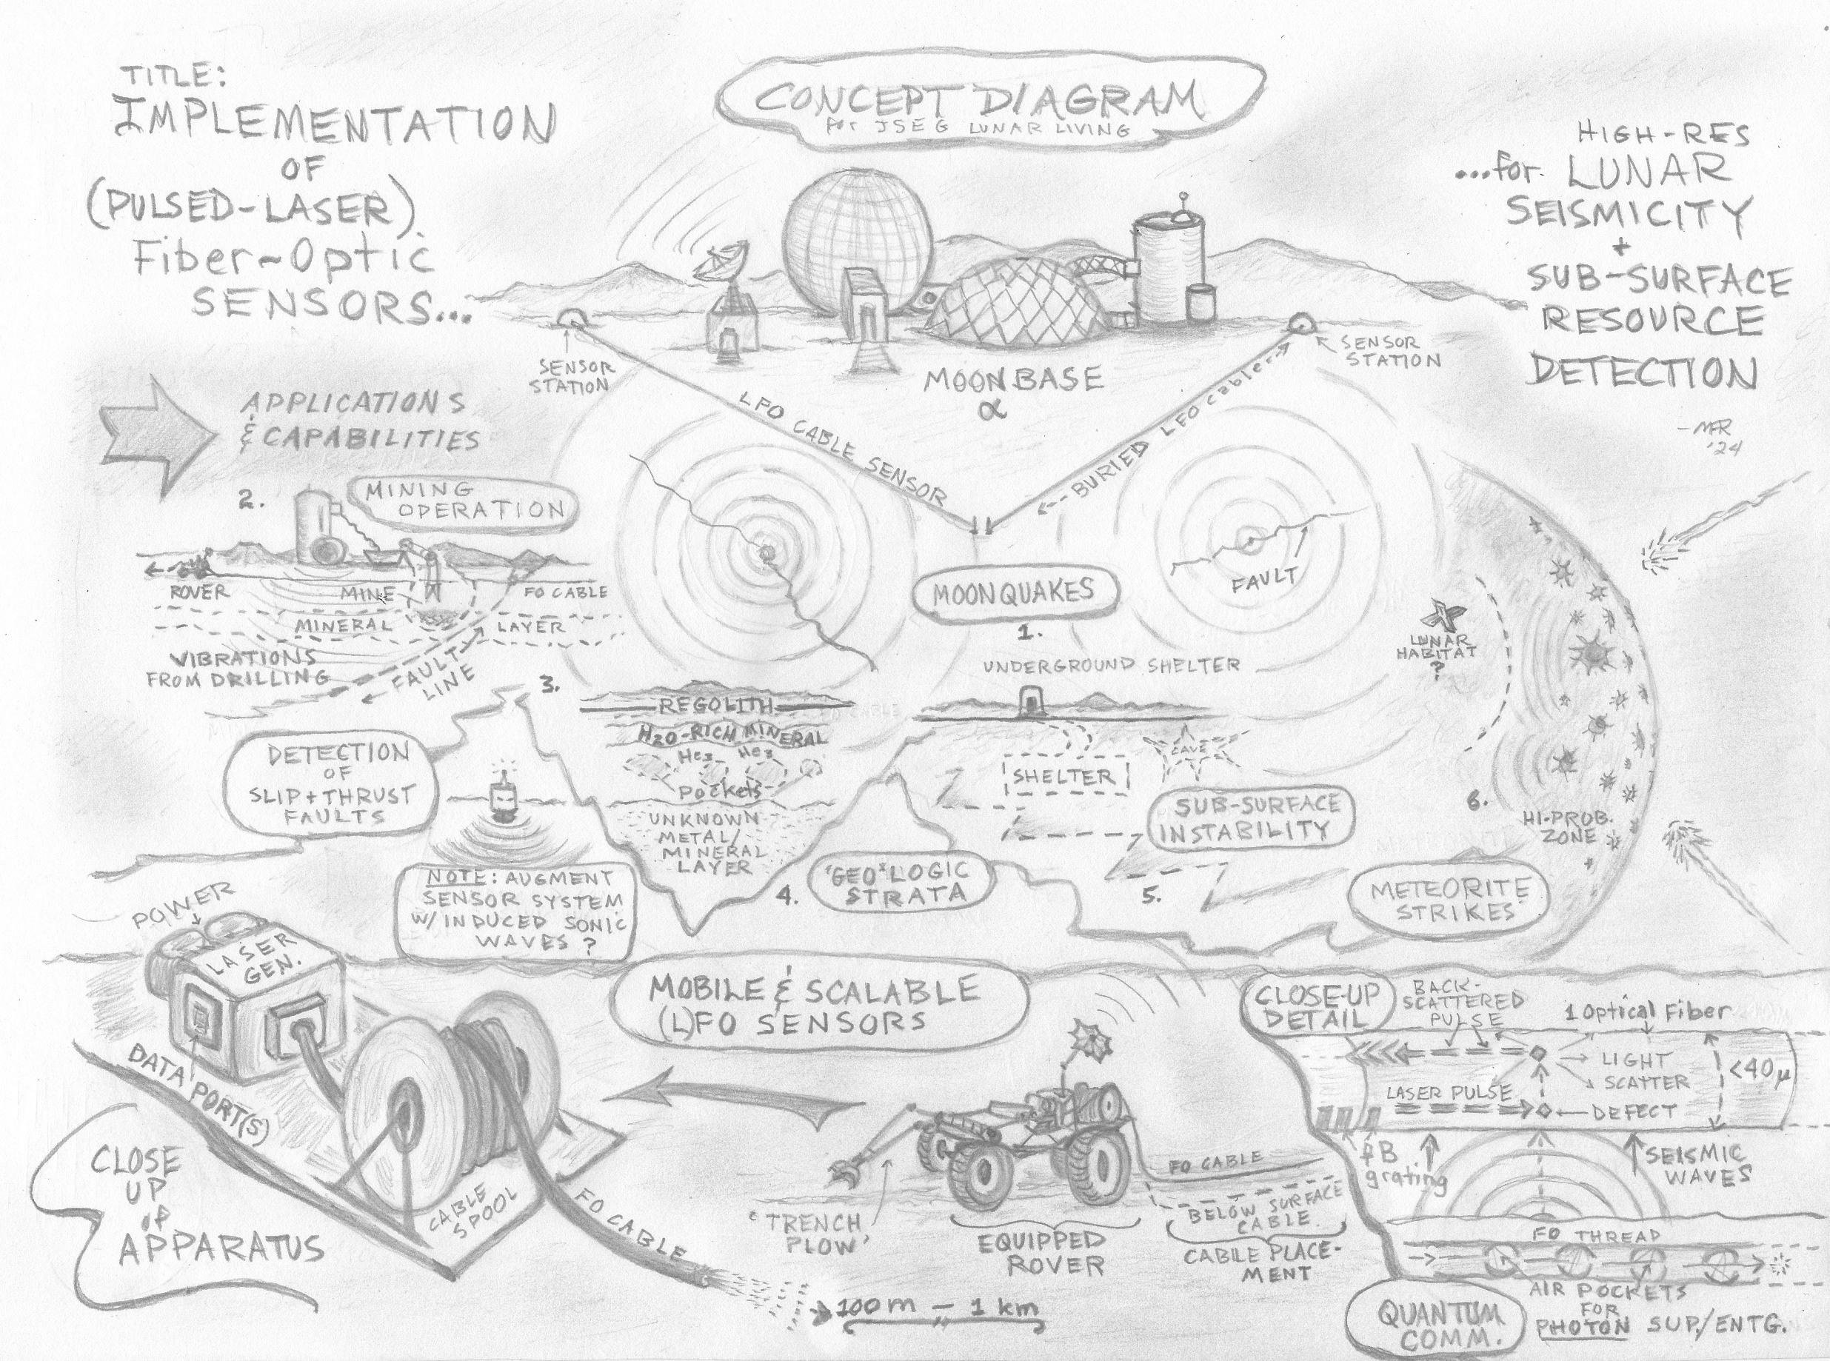

Slide 5
Close-up Detail of Concept Design – pLFO Tech & Rover-installed Apparatus

Slide 6
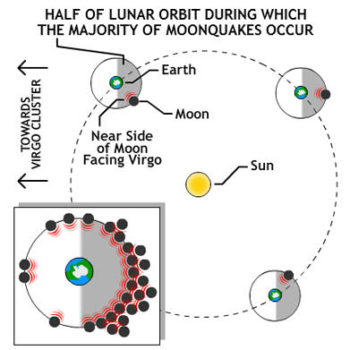
Special Case Usage of pLFO sensors : Unknown Lunar Fault Zone Detection
(reference: Z. Zhan, CIT - 2021 Science feature article reference)

Slide 7
Technical Challenges / Obstacles for implementation of pLFOs:
Large Data sets – terabytes –> petabytes
Solutions:
- use of AI for pattern recognition – relevant data v. noise (or ‘baseline’ data)
- improved software > data compression, etc. and/or dedicated servers at
Moonbase (or on Earth / ISS via satellite transmission relay)
Weight of FO cables for extended distance deployment – transported via rovers (or other lunar utility vehicle) – probable lunar rover power drain
Solutions:
- length limit / scaling - multiple area/zone measurements with same cable –
Deploy, Retrieve, Re-Deploy (DR-RD) – targeted deployment for more efficient
detection/monitoring
- use of rover teams (2 or more rovers, with shorter cable units, per zone)

